Slide 1

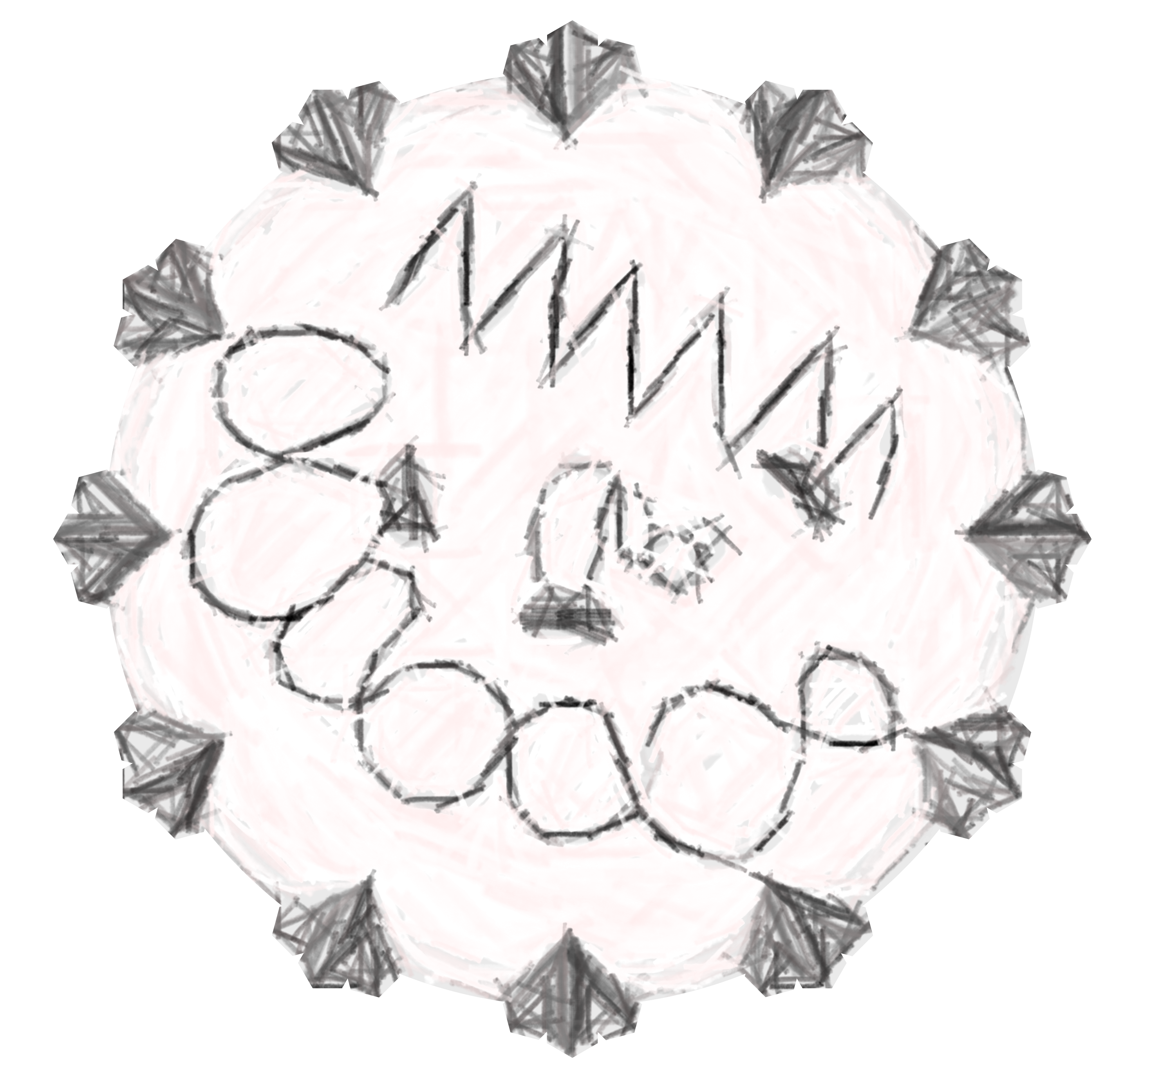



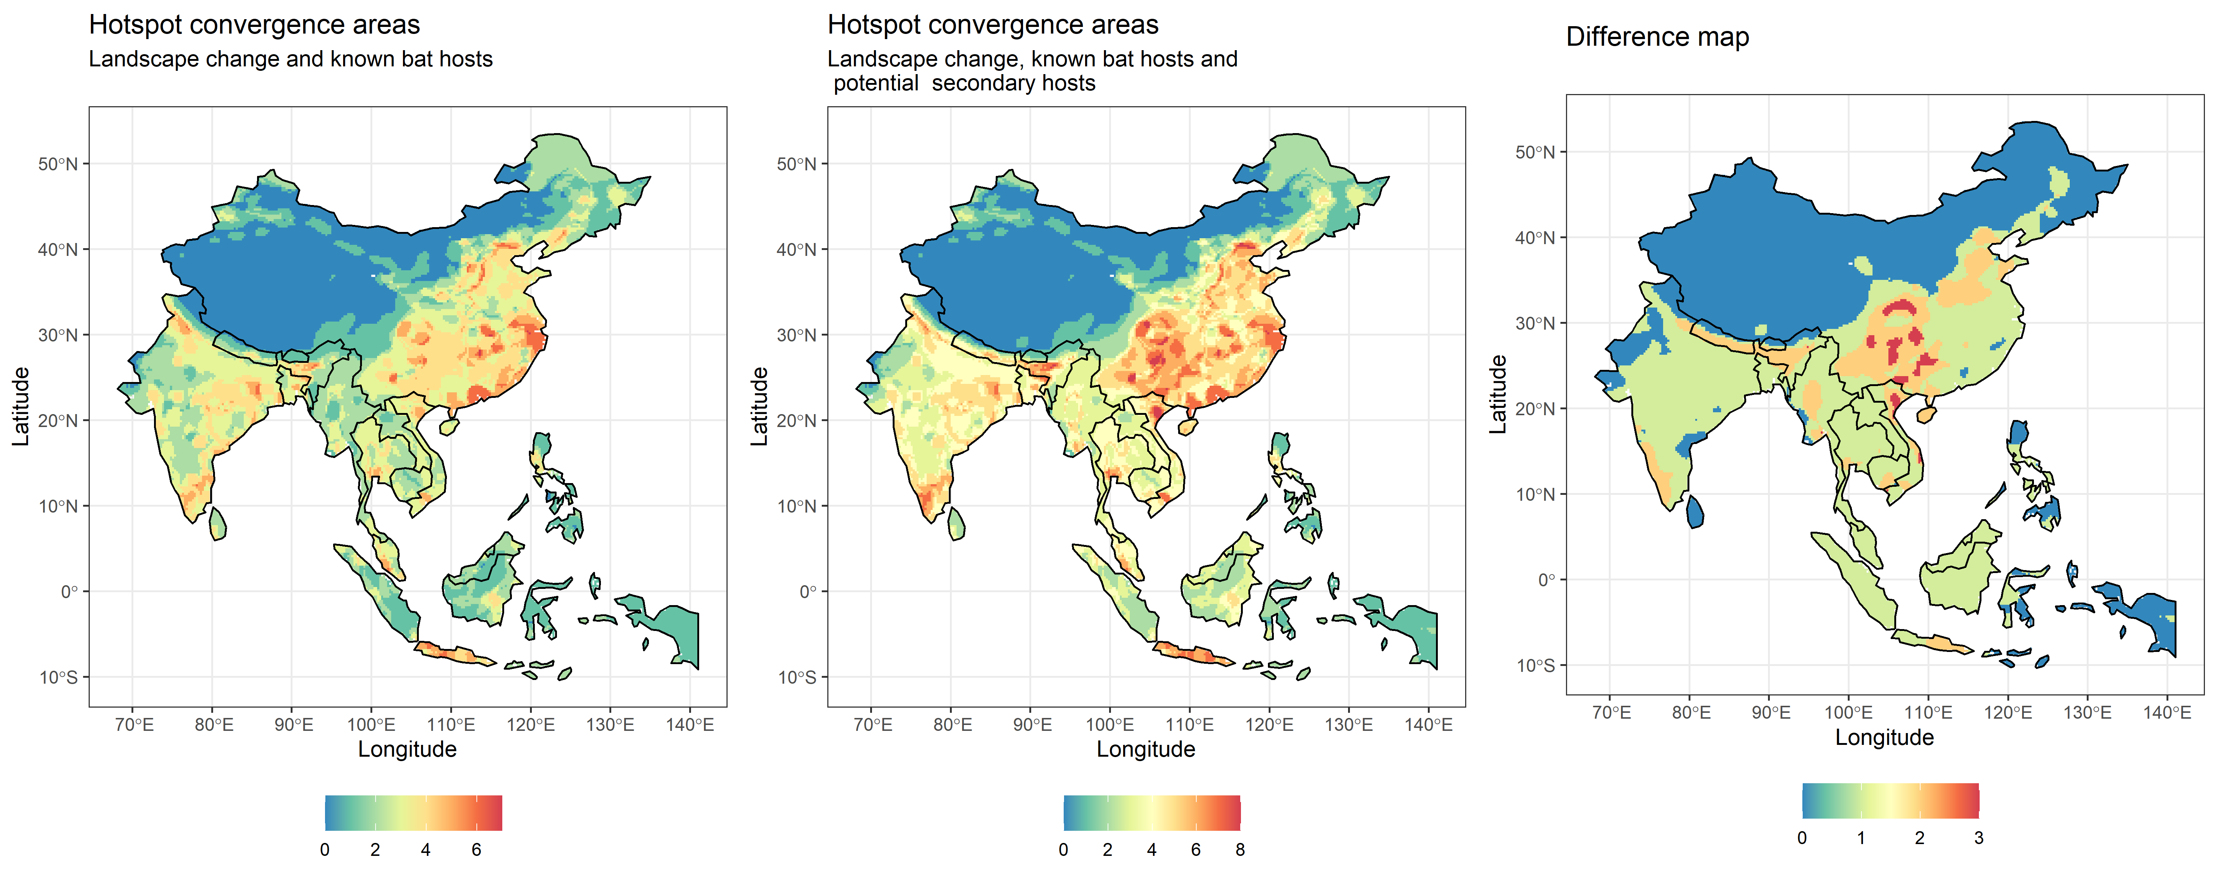
Figure 2

Slide 2
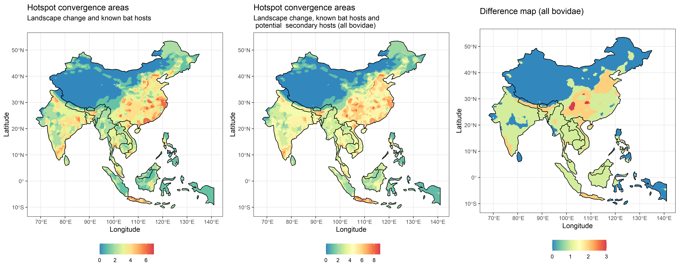
Figure 2

Slide 3
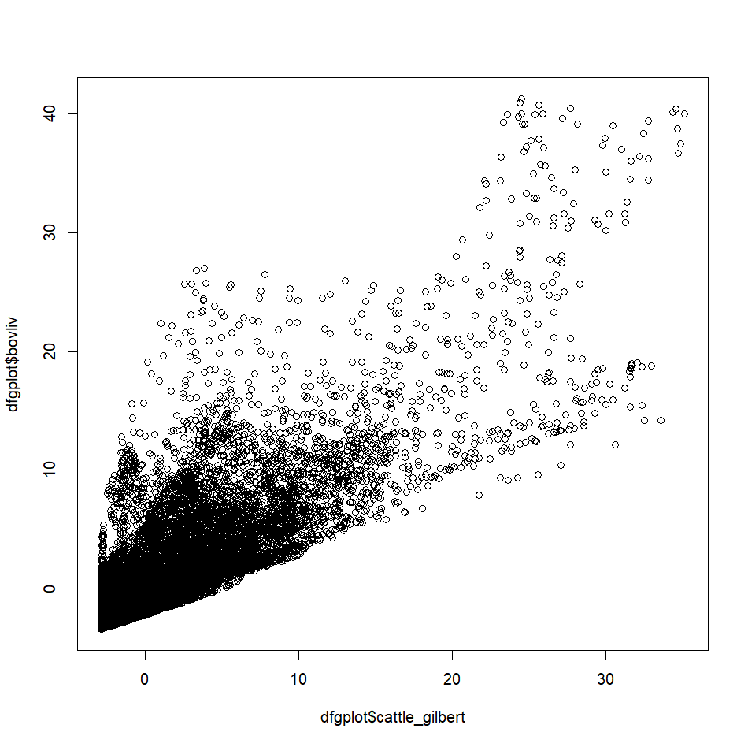
So apparently summing them makes the hotspots less intense, by spatially evenning out the values for livestock. This may be even more reallistic for hazard
> max(p$cattle_gilbert)
[1] 68677.8
> max(p$buffalo_cattle_goat_sheep)
[1] 104970.1

